Slide 1
WARNING
These slides are not optimized for printing or exam preparation. These are for lecture delivery only.
These slides are made for PowerPoint 2013. They may not show up well on other PowerPoint versions.
These slides contain a lot of animations. For optimal results, watch in slideshow mode.

Slide 2
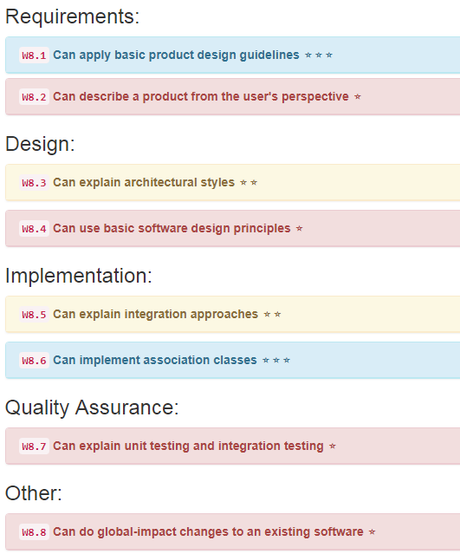

Slide 3
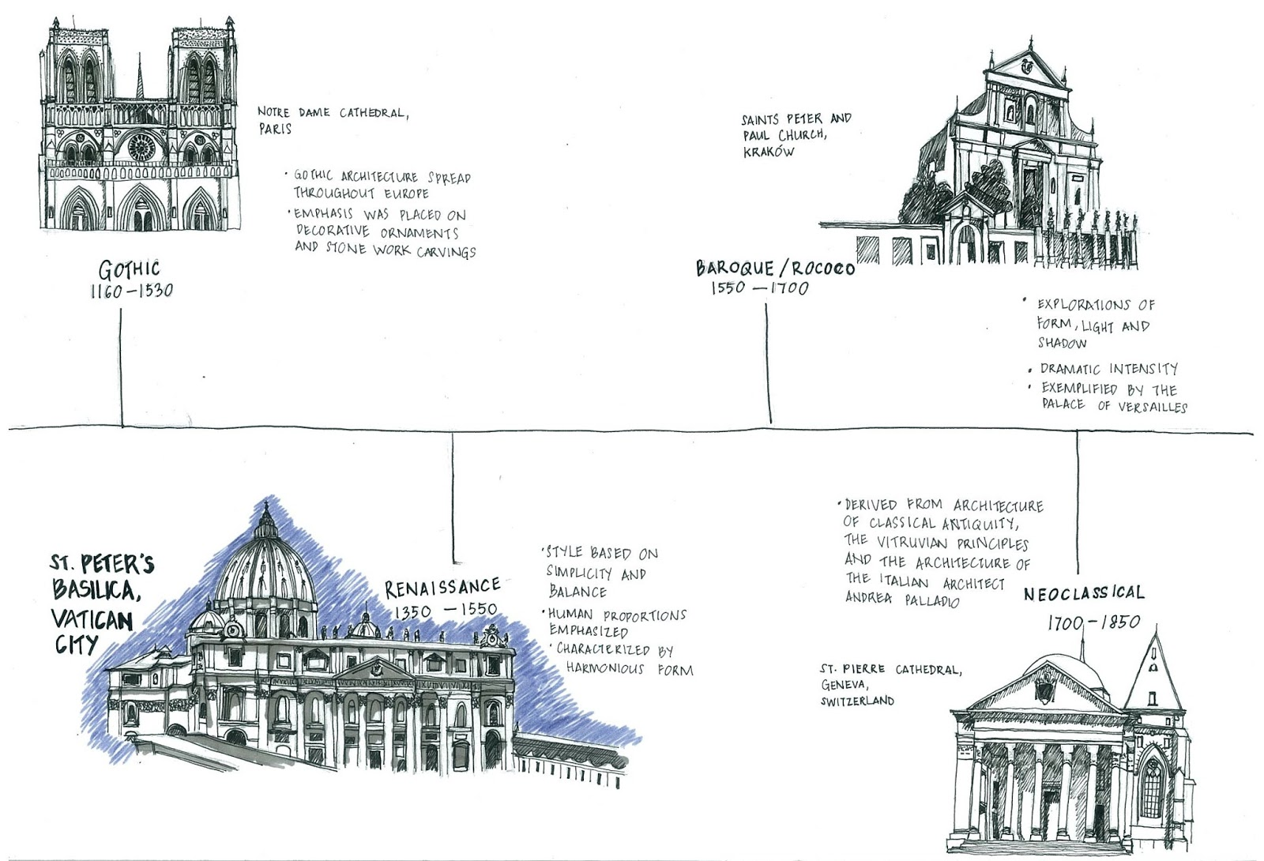
L6P1 Architecture
styles

Slide 4
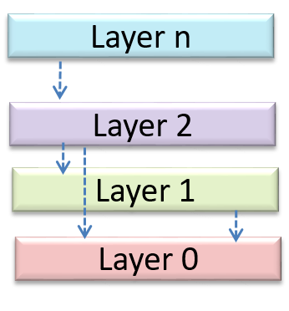
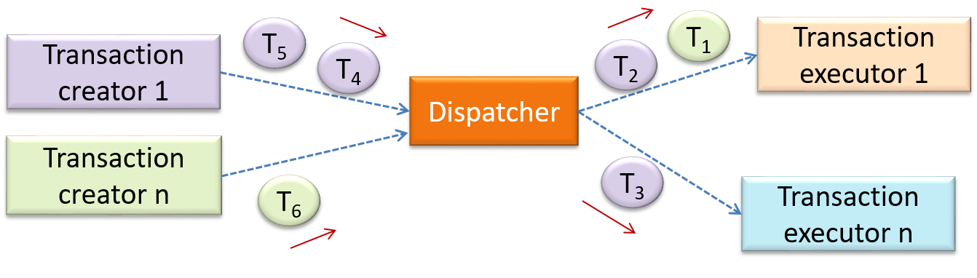
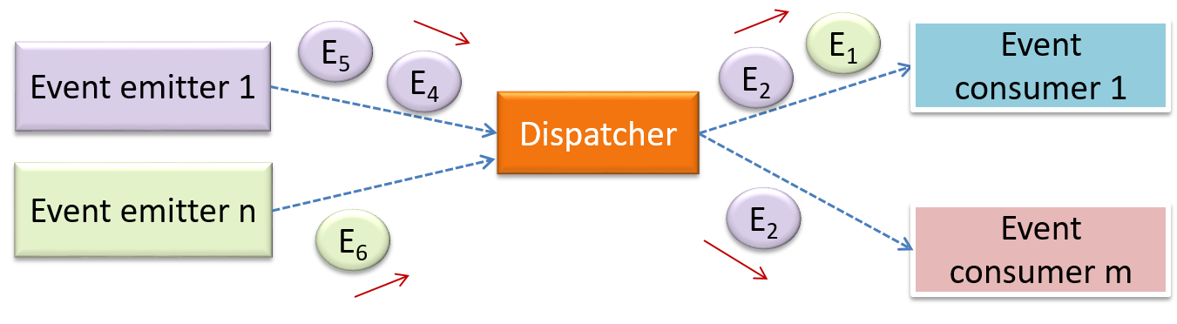
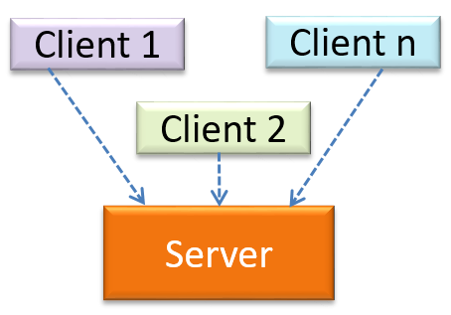
L6P1 Architecture
styles

Slide 6

E7P1 Coupling and Cohesion
Increase or decrease?

Slide 7
Revisit: Comment on coupling & cohesion in the following code:
/* Sets user as ‘active’ on the server. * @throws CannotActivateException if the user does not exist
* on the server
*/
void activateUserOnServer(String userName)
throws CannotActivateException{
log("trying to activate");
assert isUsernameAcceptable(userName);
ServerConnection.activate(userName);
if(!ServerConnection.isActivated(userName)) {
throw new CannotActivateException(userName + " not activated");
}
Account account = AccountManager.getAccount(userName);
account.toggleActivatedStatus(); //mark as activated
}
1
2
3
4
5
6
7
8
How does this affect coupling and cohesion?

Slide 8

Principle of Separation of Concerns (SoC)
SYSTEM
Refresh data storage
Interact with user
Show message to user
Authenticate user
Get user input
Store user data
Encrypt password
by Edsger Dijkstra

Slide 9
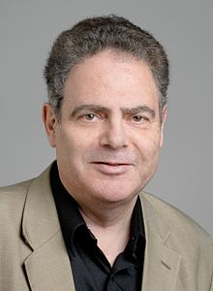
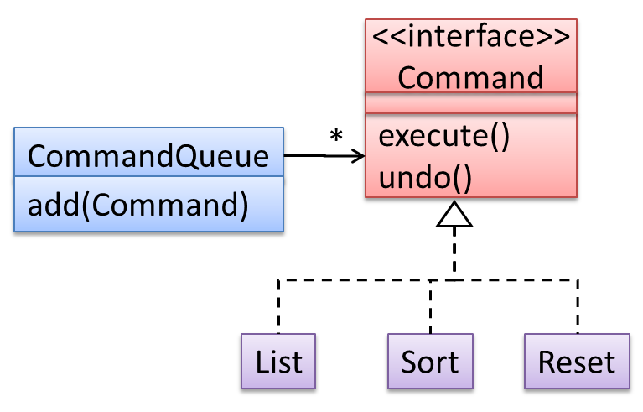
Open-Closed Principle (OCP)
A module should be open for extension but closed for modification.
by Bertrand Meyer

Slide 11
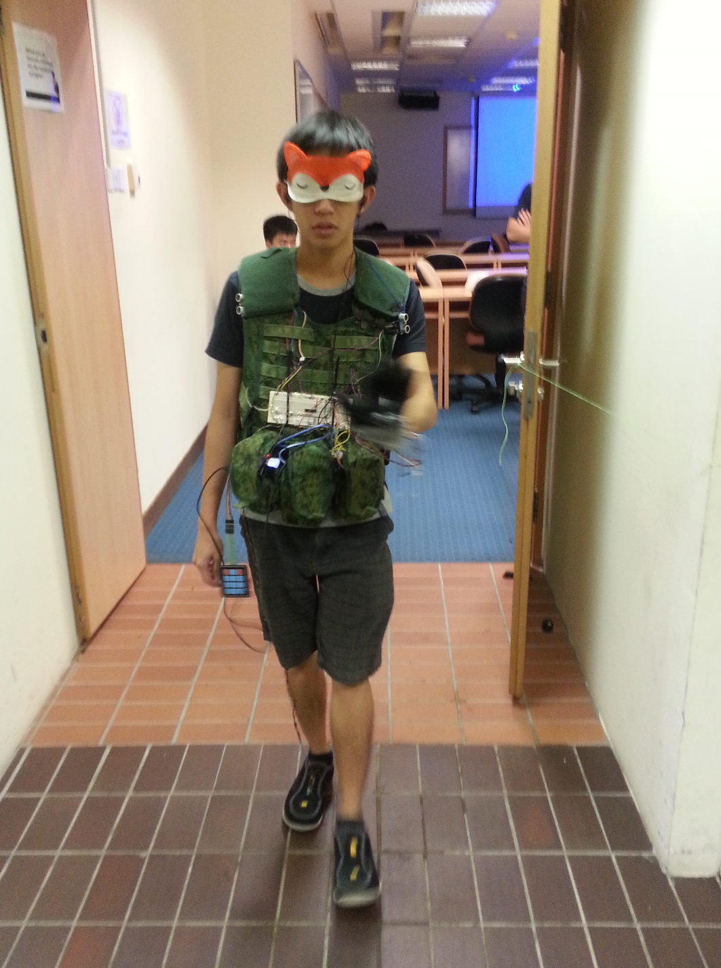
E7P2 Integration Process
Real Story: The embedded system project I teach has two full system tests in week 10 and week 13. The project consists of 3 major components: Hardware, Firmware and Software. The components were tested separately in week 7 with minimal requirements.
As a responsible student, when should you aim to start testing the full system?

Slide 12
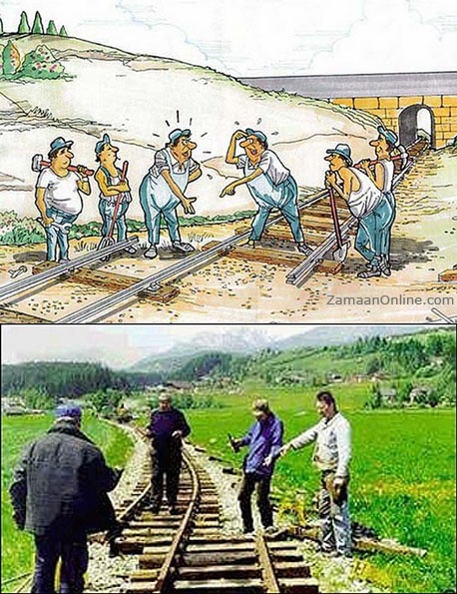
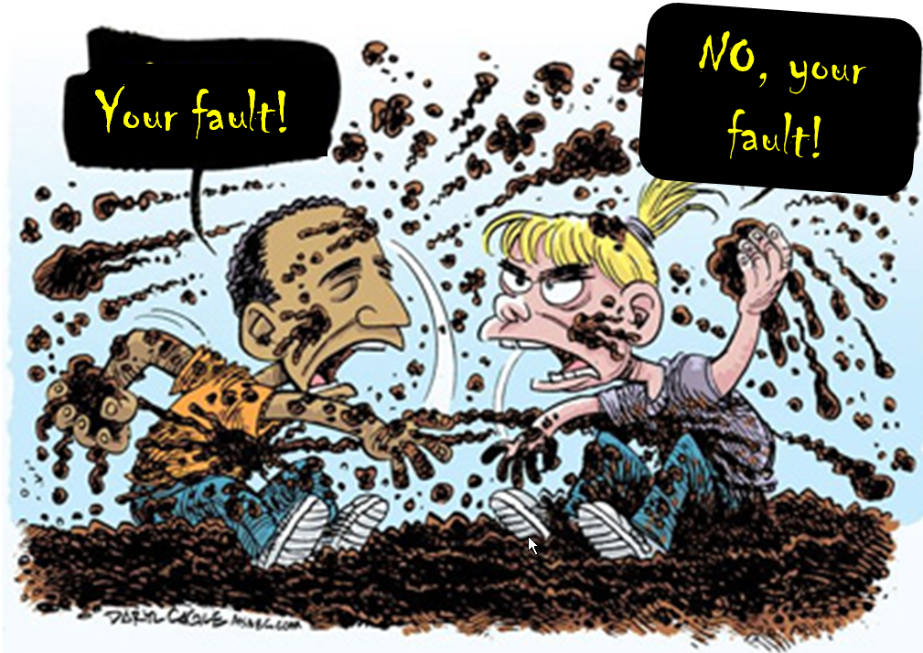

Slide 13
UI
UI
MSLogic
History
MSLogic
History
Storage
Storage

Slide 15
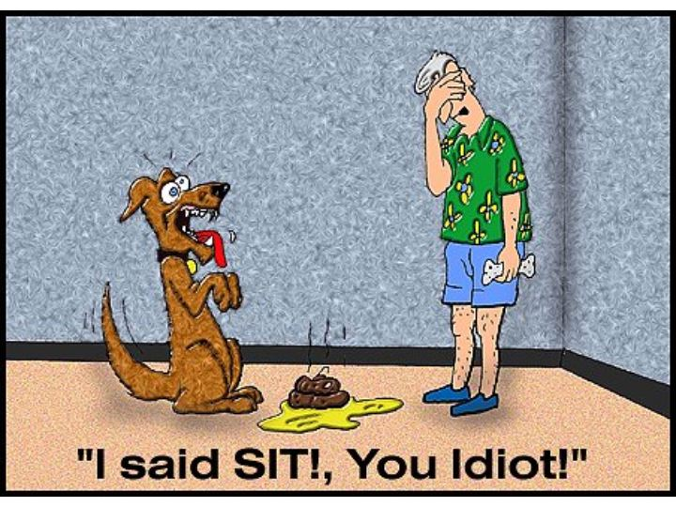

Slide 16
Due to miscom

Slide 17
Due to miscom

Slide 18
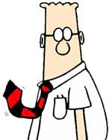
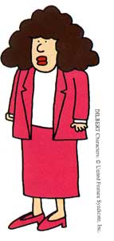
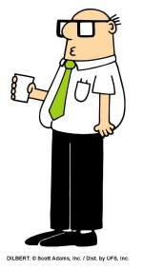
Integration approaches
When?
How much?
In what order?
UI
UI
Why does Address Book seems “safer” in this regard?
UI
Logic
Search
Logic
Search
Logic
Search
Cache
Storage
Storage
Cache
Storage
Cache

Slide 20
Example from a Library System:
Student
Book
borrows
Where to put return date?

Slide 21
Student
Book
borrows
Student
Book
borrows
Loan
Association classes
returnDate
How to implement?
You already know the answer…..

Slide 23
Developer testing
Regression testing
Unit testing
Integration testing
………………. testing

Slide 26
Must remain command based
(by keyboard input)
command
Result summary
Item
Web page
Item
Item
Item
status bar

Slide 27
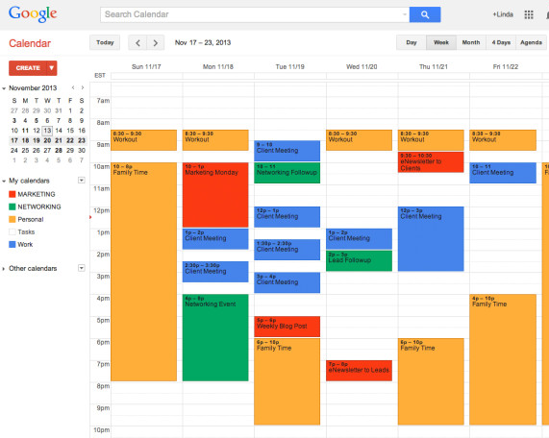
command
Result summary
Item
Web page
Item
Item
Item
status bar

Slide 28
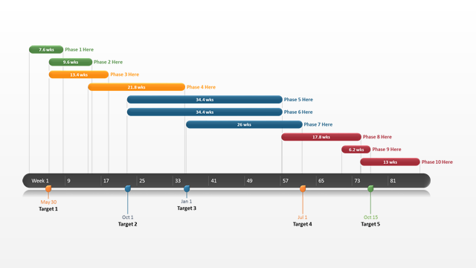
command
Result summary
Item
Web page
Item
Item
Item
status bar

Slide 29
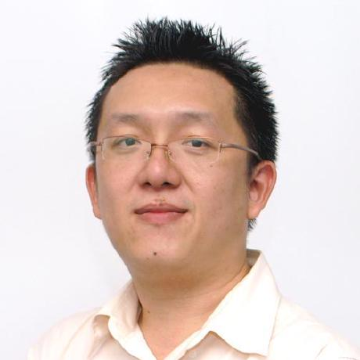
command
Result summary
Target
Web page
Target
Target
Target
status bar

Slide 30
command
Result summary
Item
Item
Item
Item
Item
Item
Item
Item
Item
Item
Item
status bar

Slide 31
command
Result summary
Item
Item
Item
Item
status bar

Slide 32
Item
command
Item
Response
Item
command
Item
Response
command
Error response
status bar

Slide 33
Designing the product

Slide 34


Slide 35

That's the thing about people who think they hate computers. What they really hate is lousy programmers.
— Larry Niven

Slide 36
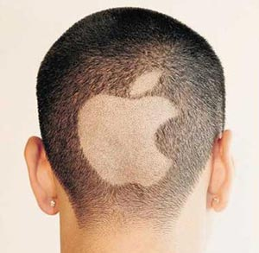

Slide 37



Slide 40
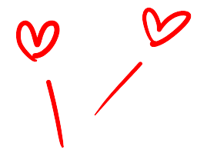
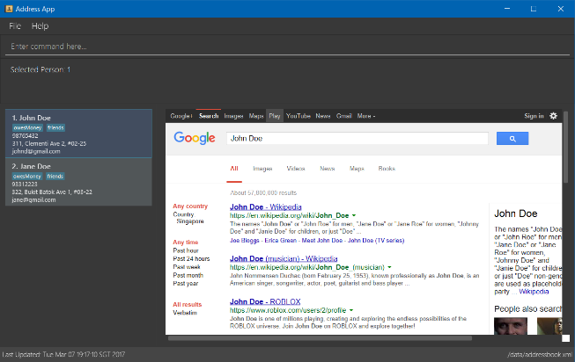

Slide 41


Slide 42

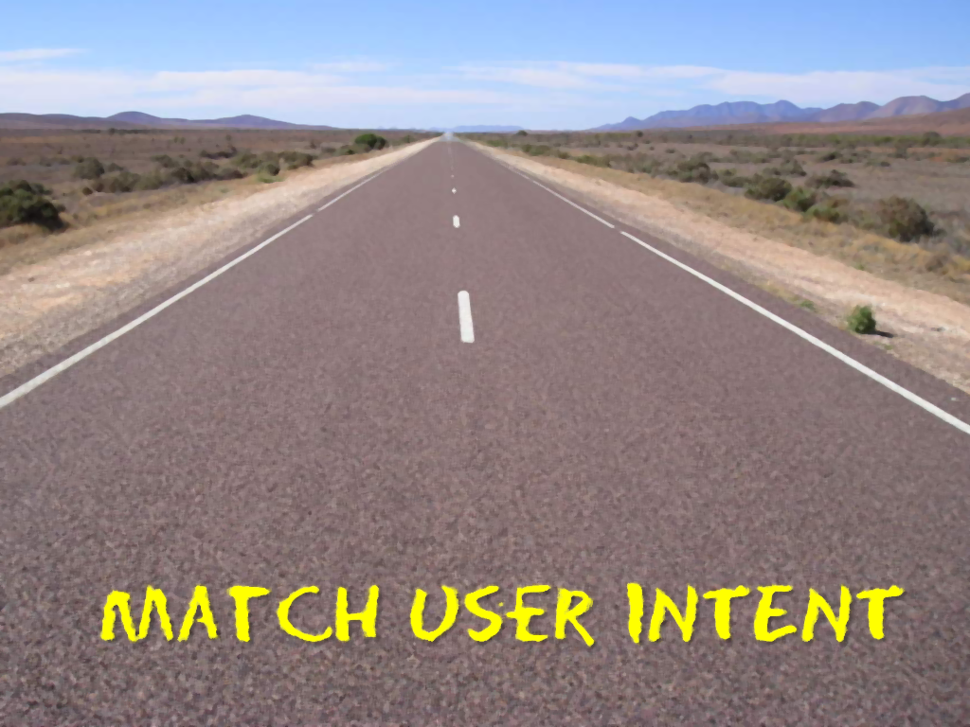

10
10
10
10
OBSERVATIONs about PRODUCT DESIGN

Slide 43


Slide 44
10
How to apply in the project?
Value to user, not you

Slide 45
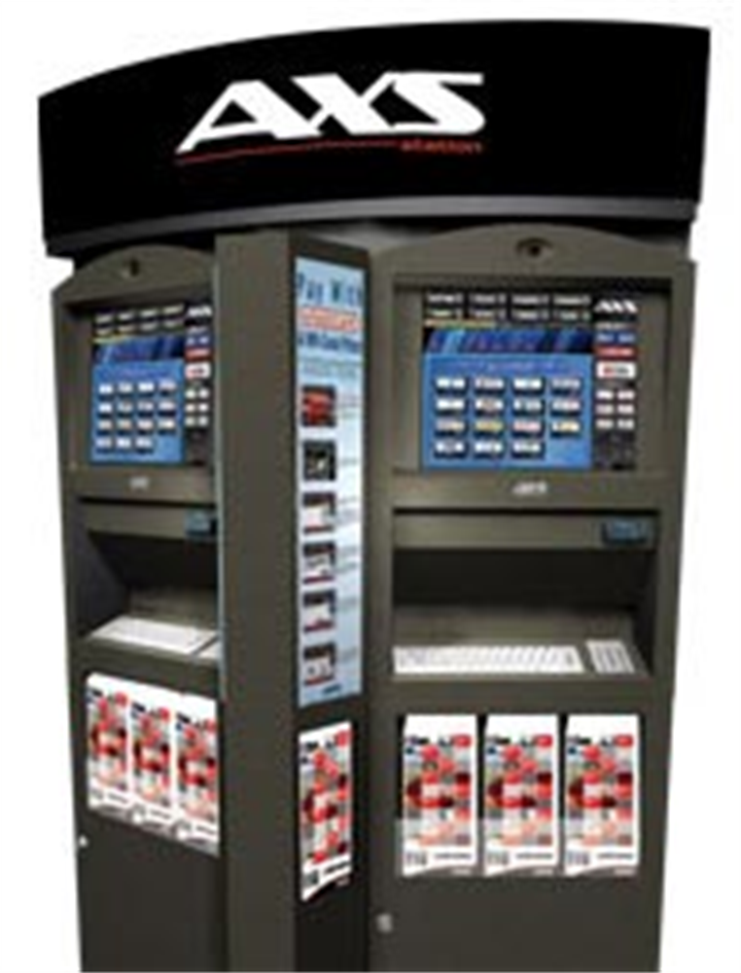

Slide 46
How many steps should it be (assume you are trying to minimize steps)?
3
2
1
0
Answer on Archi

Slide 47
Real program can't be that tedious….
Or can they?
Why don’t they reduce the number of steps?

Slide 48
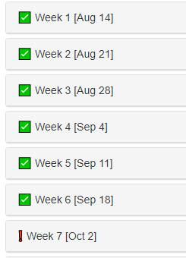
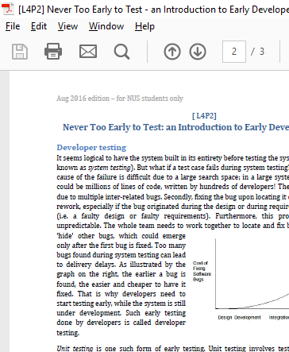
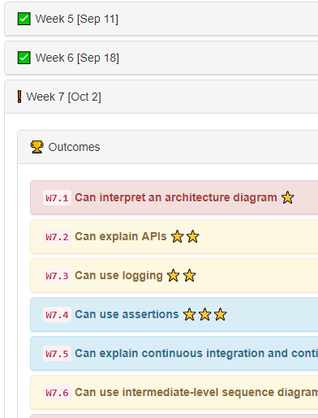
So many clicks!
How about 0 clicks?
n-2 clicks

Slide 49
9
How to apply in the project?
MINIMIZE WORK FOR USERS

Slide 50
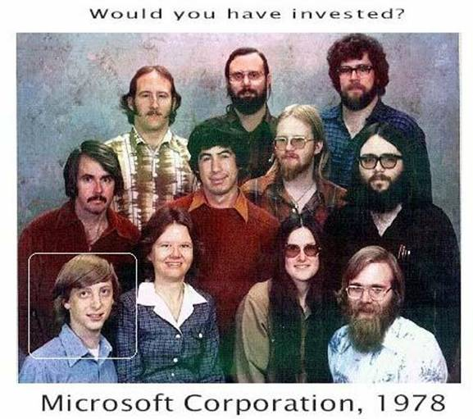

Slide 52
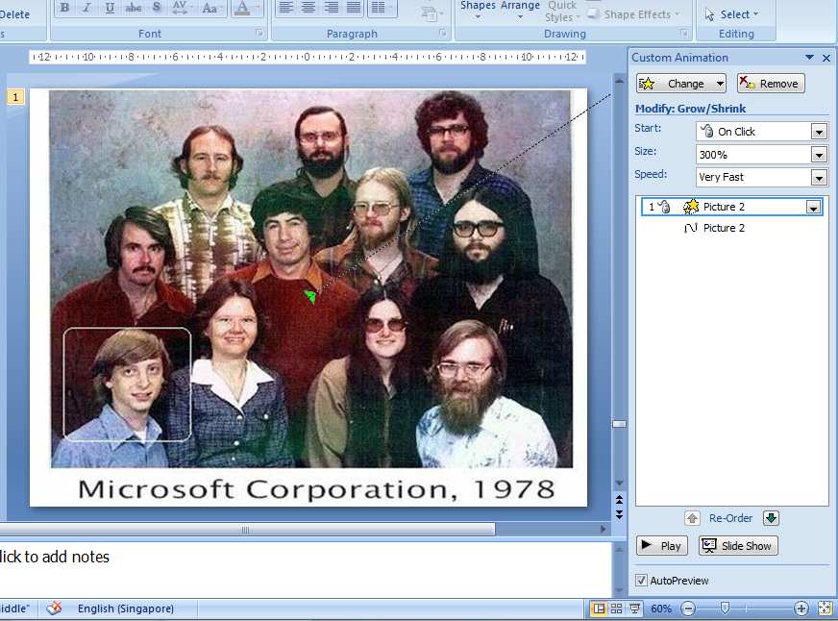

Slide 54

Zoom this!

Slide 55
8
How to apply in the project?
Match user INTENT

Slide 56
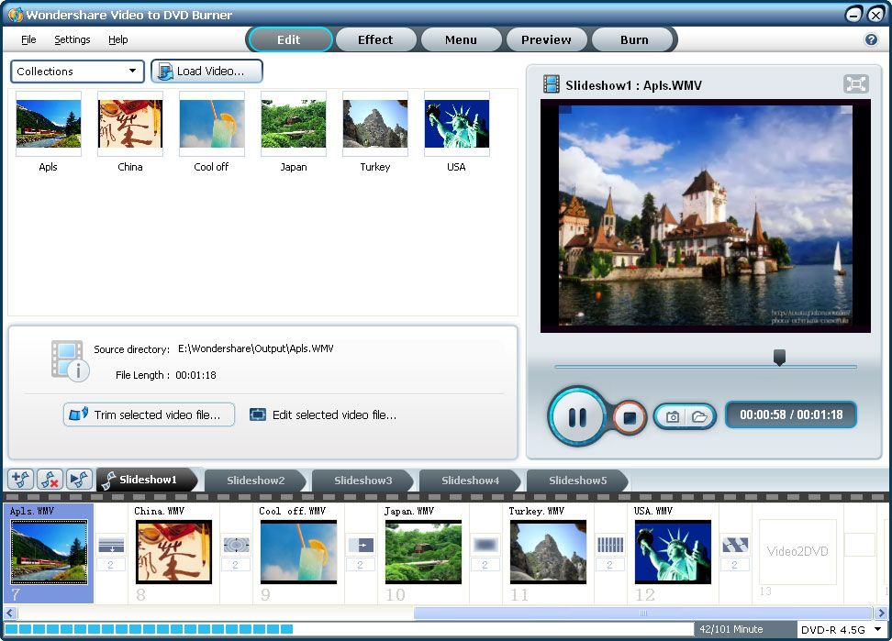

Slide 57
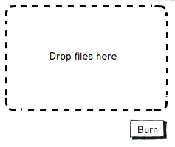

Slide 58
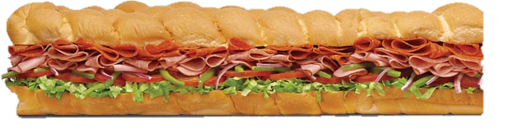

Slide 59
7
How to apply in the project?
less is more

Slide 60
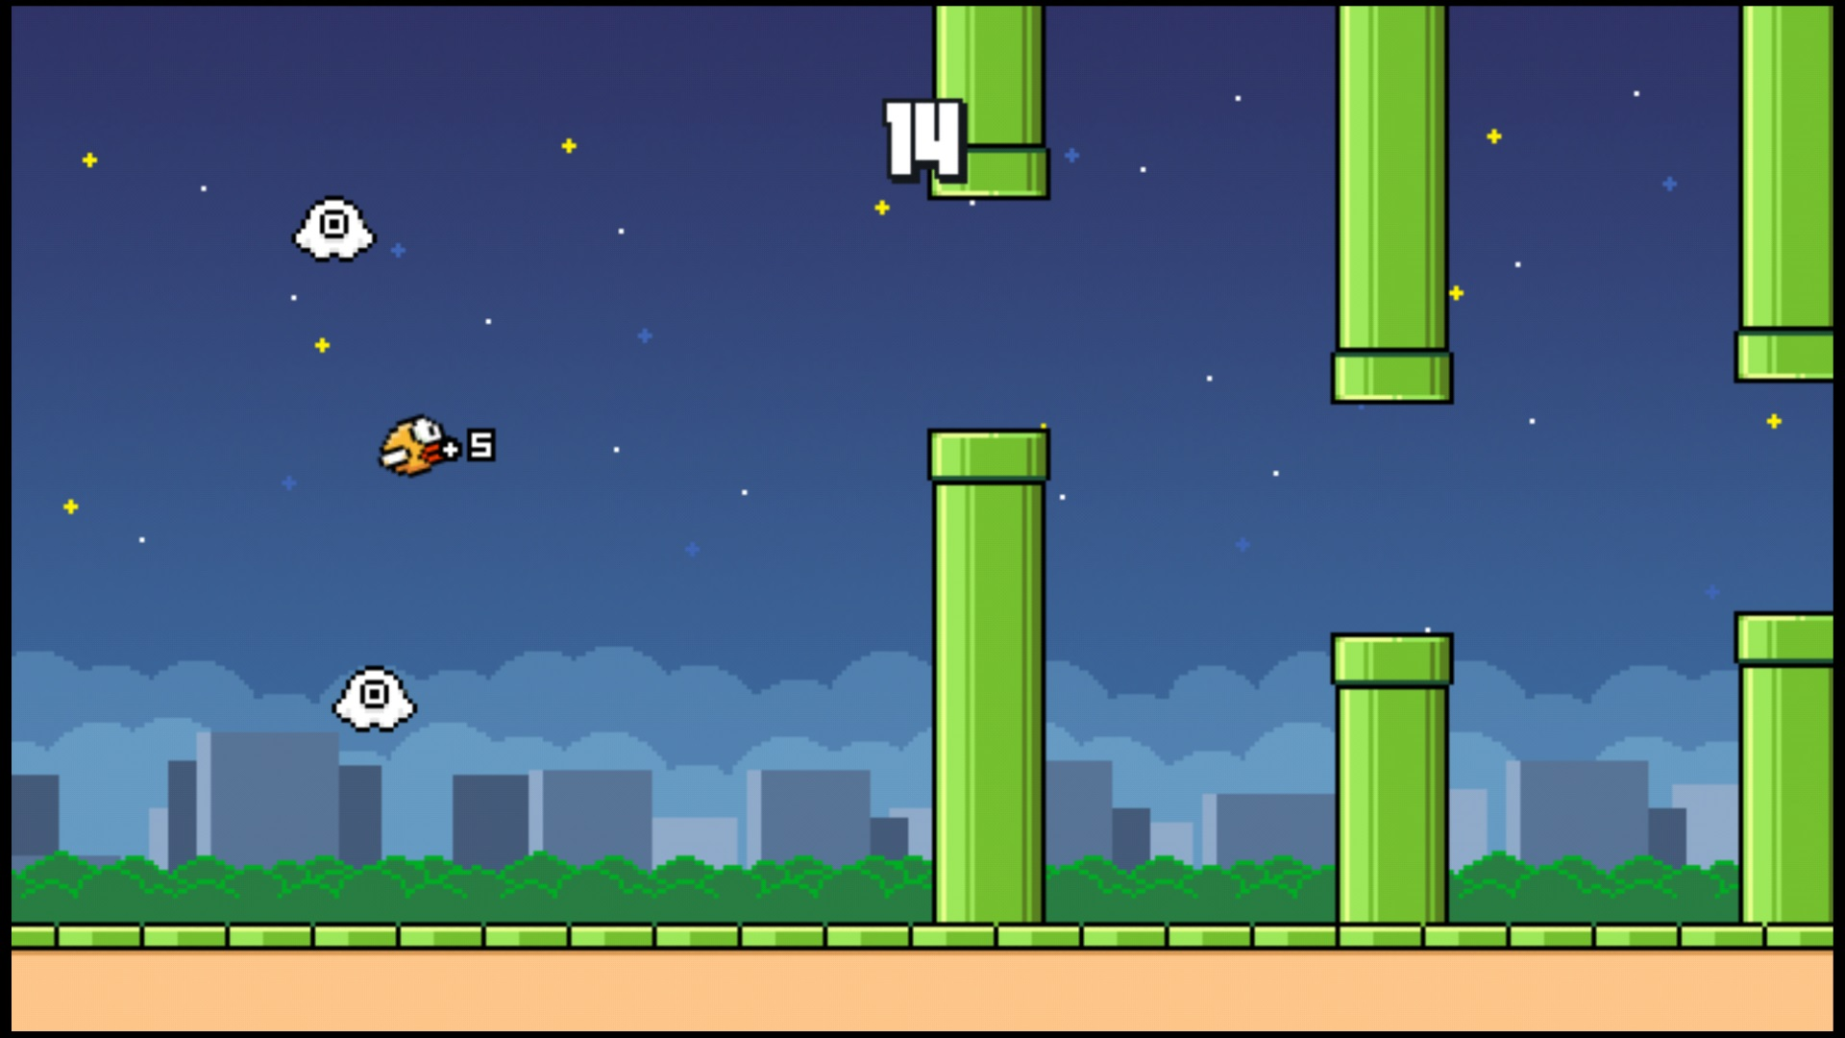
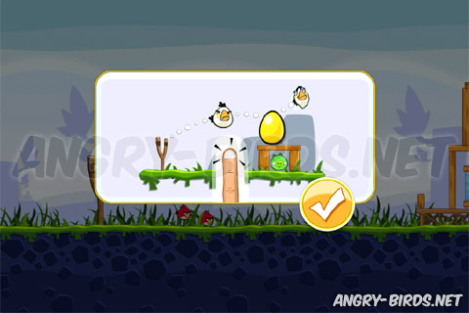

Slide 61

Make users productive within minutes of first contact
Notes:
Make users productive within minutes of first contact

Slide 62
6
How to apply in the project?
DON’T FORCE TO RTFM

Slide 63
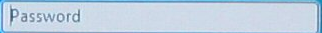
Username
Password
Button

Slide 64
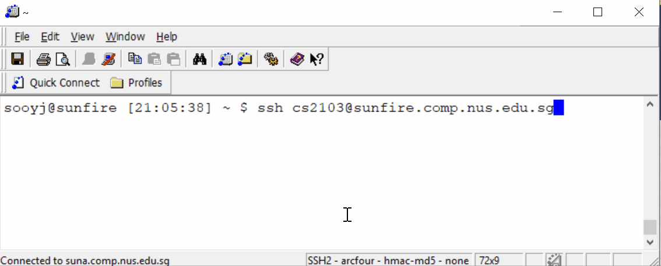

Slide 65
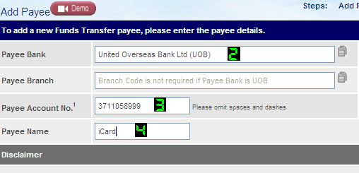

Slide 66
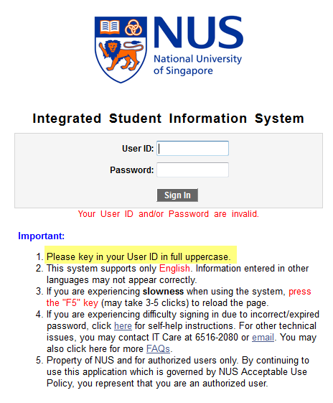

Slide 67
5
How to apply in the project?
dON’T make USERS FEEL STUPID
Notes:
-> minimize errors, forgive errors, guide recovery

Slide 68
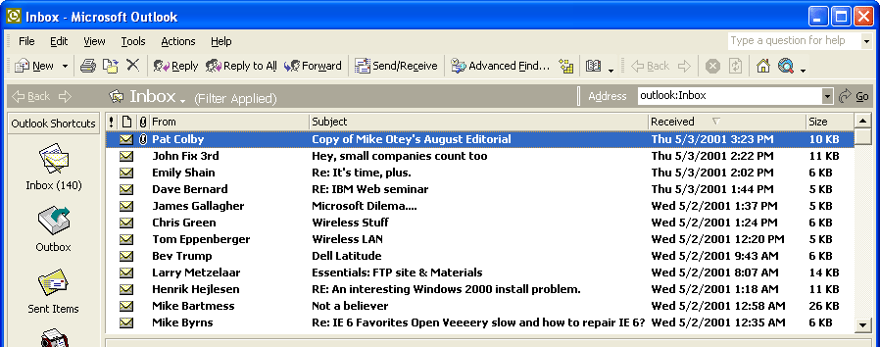
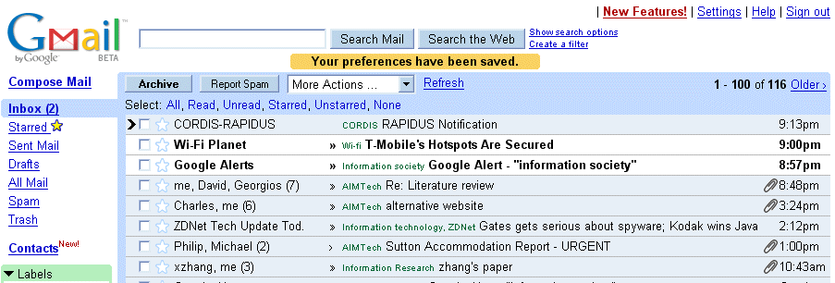

Slide 69
4
How to apply in the project?
Benefits,
Not features

Slide 70
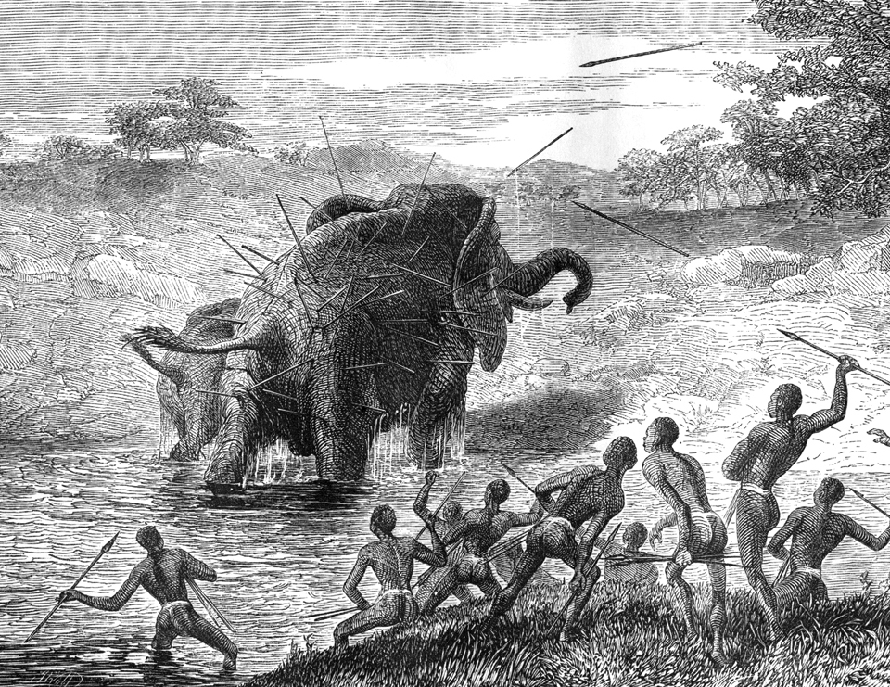

Slide 71
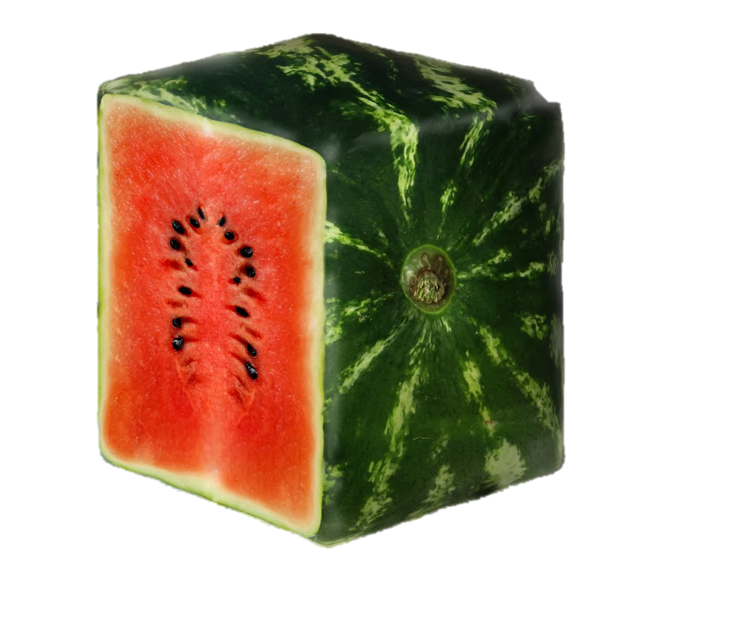


Slide 72
3
How to apply in the project?
Be everything to somebody

Slide 73


Slide 75
2
How to apply in the project?
VISUALIZE USAGE

Slide 76
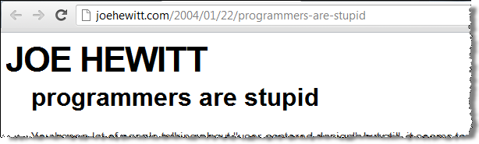
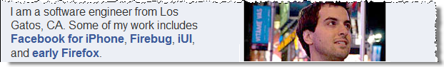
… User's aren't stupid; they just simply aren't programmers. Users are all smart and knowledgeable in their own way. They aren't all "Grandmas" - they are doctors and lawyers and accountants, who are struggling to use the computer because programmers are too "stupid" to understand law and medicine and accounting.

Slide 77
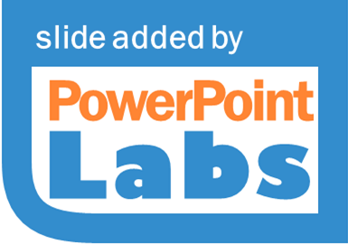
… User's aren't stupid; they just simply aren't programmers. Users are all smart and knowledgeable in their own way. They aren't all "Grandmas" - they are doctors and lawyers and accountants, who are struggling to use the computer because programmers are too "stupid" to understand law and medicine and accounting.

Slide 78




… User's aren't stupid; they just simply aren't programmers. Users are all smart and knowledgeable in their own way. They aren't all "Grandmas" - they are doctors and lawyers and accountants, who are struggling to use the computer because programmers are too "stupid" to understand law and medicine and accounting.

Slide 79


Bug free
quality code
Fast
on time
follows the spec
Cool UI
BUT not liked by users

Slide 80
1
CARE

Slide 81
10
10
10
10
OBSERVATIONs about PRODUCT DESIGN

Slide 82
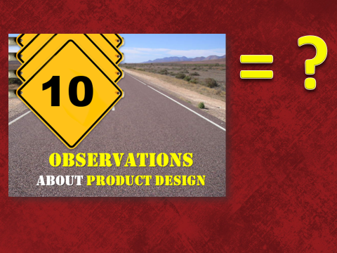
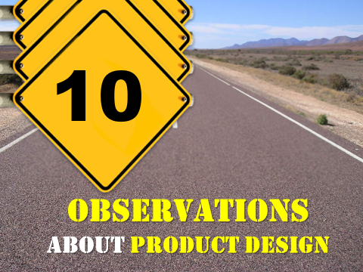

Slide 83


= ?

Slide 85
